Slide 1
Evropské bioekonomické konference PaedDr. Pavla Břusková

Slide 2
Konference IFIB 2019, 3.-4. října 2019 v Neapoli International Forum on Industrial Biotechnology and Bioeconomy
organizuje Assobiotec, italská Asociace pro rozvoj biotechnologií, společně s Innovhub-SSI, italským Klastrem zelené chemie SPRING, Regionem Campania, Univerzitou Federico II a S.I. Impresa – Hospodářskou komorou v Neapoli.
zúčastnilo se cca 250 osob z 30 zemí (OECD, European Forest Institute, Kanada, Brazílie, Austrálie, Řecko, Irsko (Státní agentura pro zemědělství a Irish Bioeconomy Cluster), Slovensko (Bioeconomy Cluster of Slovakia), Velká Británie, …
Na IFIB se představili inovativní firmy v bioekonomice, jako je LanzaTech (USA), Fater (IT), Novamont (IT), Terravesta (UK), Pirelli (IT) a Sulzer (CH), výzkumná centra National Research Council of Italy, VTT of Finland, Wageningen University a Fiat Automotive Research Center.
za ČR se zúčastnili: Nikola Sagapová, Pavla Břusková (JČU, projekt P4B) a Markus Dettenhofer (CEITEC, projekt CELEBio)
IFIB is going to Rome: 1-2 October 2020

Slide 3
Prezentace z IFIB 2019 dostupné on-line z web stránky programu konference: https://ifibwebsite.com/program/
Industrial and innovation ecosystems in selected OECD countries - Jim Philp, OECD
Bioeconomy Cluster Slovak approach to bioeconomy - Katarína Blicklingová, Bioeconomy Cluster (Slovakia)
Conventional biofuels still biggest contributor to EU transport decarbonisation - James Cogan, Pure Fiber (Ireland)
Energy in Transition Port of Rotterdam - Stijn Effting, Port of Rotterdam (Netherlands)
Bioinspired polymers in packaging and agriculture the role of research - Mario Malinconico, CNR (Italy)
Think 2050! Making Miscanthus Meet the Demands of a Fast-Growing Bioeconomy - William Cracroft-Eley, Terravesta (UK)
Value creation from locally available biomasses and waste streams - Hendrik Waegeman, BioBase Europe Pilot Plant (BE)

Slide 4
Italian Bioeconomy Strategy – BIT II http://cnbbsv.palazzochigi.it/media/1785/bit_en_2019_02.pdf
Italská bioekonomická strategie BIT II vznikla za spolupráce národních orgánů a organizací:
Ministry for Economic Development
Ministry of Agriculture, Food, Forestry and Tourism
Ministry of Education, University and Research
Ministry of the Environment, Land and Sea
XI Committee of Italian Regions and Autonomous Provinces
Italian Technology Clusters for Green Chemistry SPRING, Agri-Food CLAN, and BlueGrowth BIG
&
THE NATIONAL BIOECONOMY TASK FORCE WHO WAS INVOLVED IN BIT II PREPARATION AND IN CHARGE FOR FACILITATING THE STRATEGY ADOPTION AND IMPLEMENTAION IN THE WHOLE COUNTRY IS COMPOSED BY:
Giancarlo Giorgetti, Pamela Morassi, Giacomo Vigna - Presidency of Council of Ministers, Coordination
Andrea Lenzi, Fabio Fava - National Committee on Biosafety, Biotechnology and Life Sciences of Presidency of Council of Ministers Technical & Scientific coordination
Fabio Fava, Franco Cotana - Ministry of Education, University and Research
Elena Lorenzini, Debora Rogges, Cinzia Tonci, Daniela A. R. Carosi - Ministry of Economic Development
Emilio Gatto, Valerio de Paolis - Ministry of Agriculture, Food, Forestry and Tourism, Annalisa Zezza (CREA)
Piergiuseppe Morone, Orecchia Carlo, Pepe Paolina - Ministry of the Environment, Land and Sea
Manuela Bora, Raffaele Liberali - XI Committee of Italian Regions and Autonomous Provinces
Catia Bastioli, Giulia Gregori, Lucia Gardossi - Italian Technology Cluster for Green Chemistry (SPRING)
Luigi Scordamaglia, Patrizia Brigidi, Maria Cristina Di Domizio - Italian Technology Cluster for AgriFood (CLAN)
Roberto Cimino, Emilio Campana - Italian Technology Cluster for BlueGrowth (BIG)

Slide 5
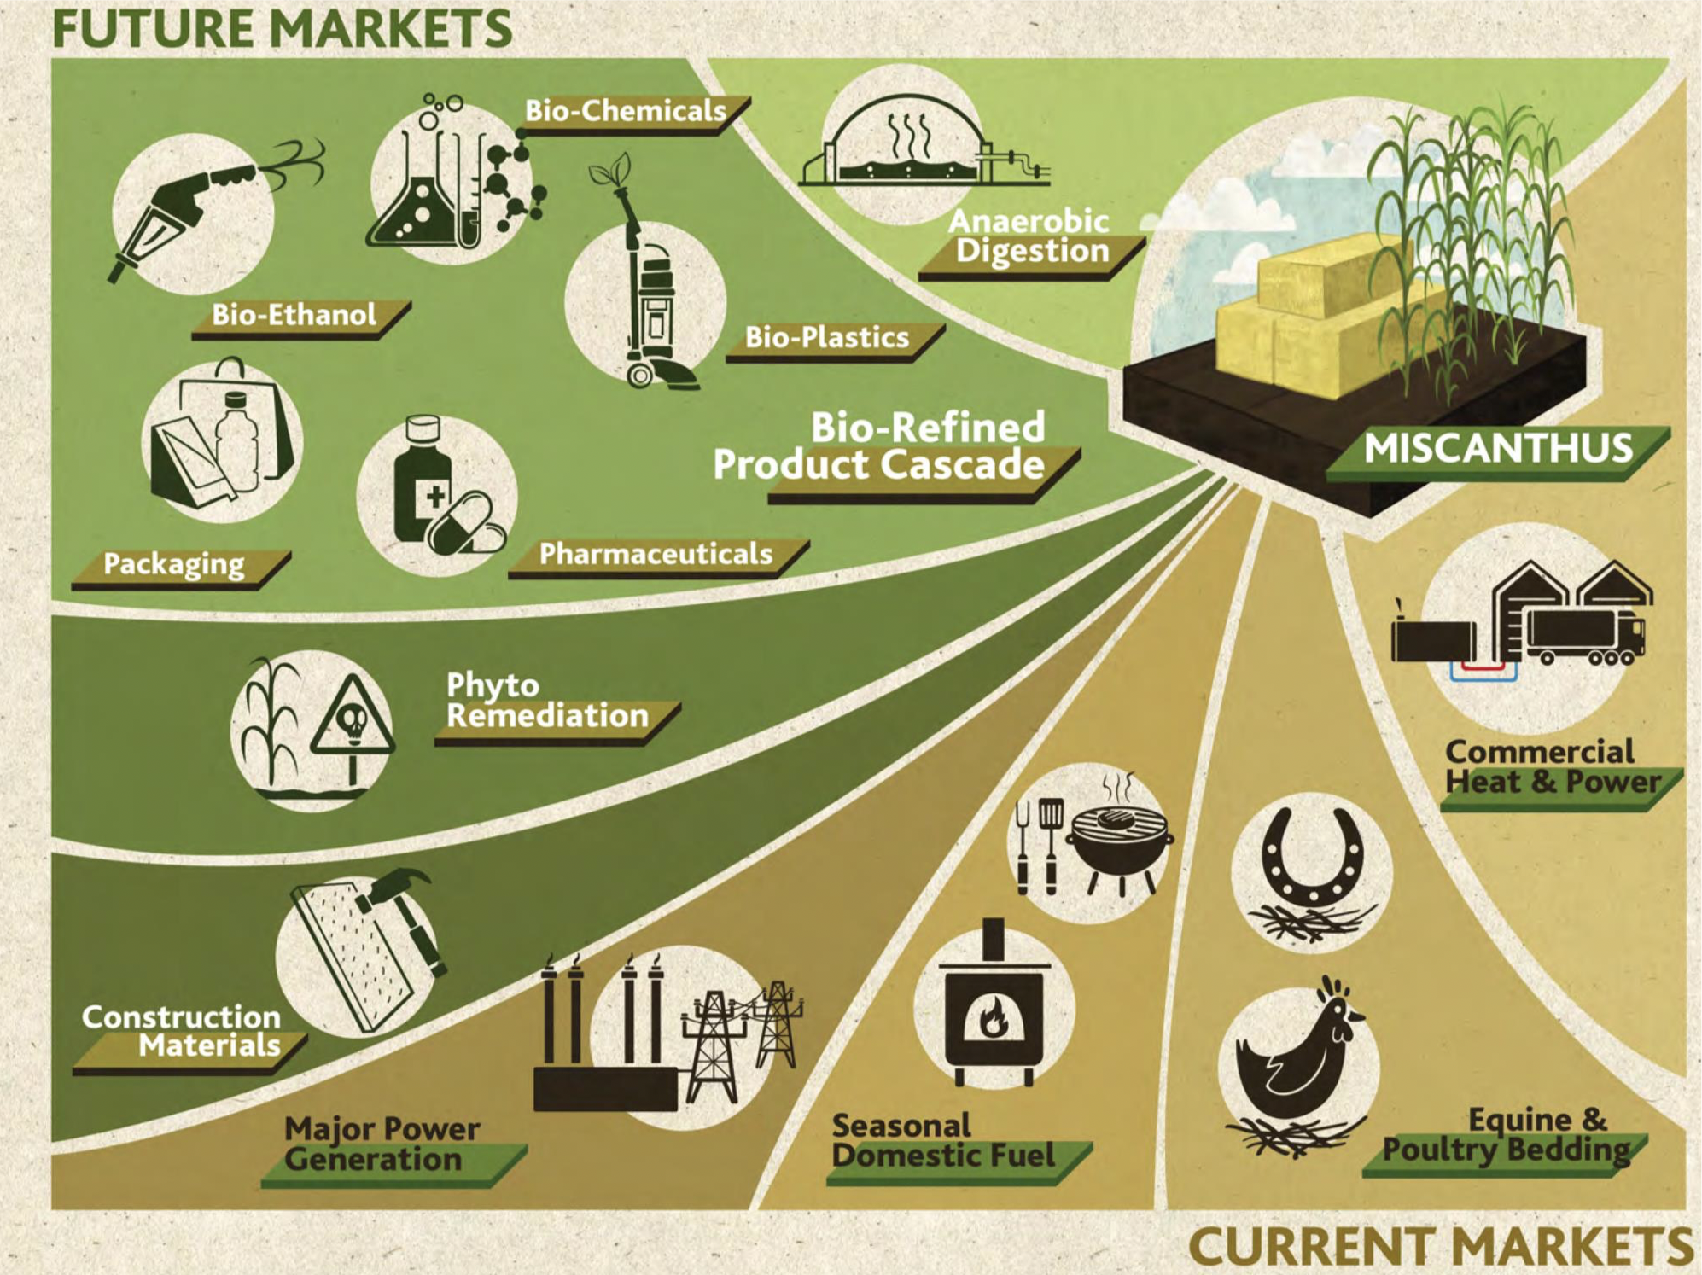
Terravesta, Velká Británie, ozdobnice čínská (miscanthus), projekt GRACE

Slide 6
www.grace-bbi.eu
Industrial case studies;
Green chemistry
Bioethanol
Bio-butanediol
Hydroxymethylfurfural (HMF)
Phenols
Green Building
Particle boards
Mycelium based panels
Insulation materials
Lightweight concrete
Green composites
Fibre reinforced (bio)plastics (FRP)
Green agriculture
Pelargonic acid
2017 – 2022
€15M
22 Partners
8 Countries – UK, France, Germany, Italy, Croatia, Netherlands, Austria, Poland
Demonstrating and optimising biomass supply chains to industry using Miscanthus and Hemp.

Slide 7
Hendrik Waegeman, Bio Base Europe Pilot Plant

Slide 8
Bioinspired polymers in food and agriculture: the role of research
Mario Malinconico Research Director at Institute for Polymers, Composites and Biomaterials, IPCB-CNR, Italy, www.ipcb.cnr.it, Italy Representative at International Science Council (ISC), President S&T Committee Assobioplastiche, www.assobioplastiche.org
Bioinspired polymers have great potential in agro-food industry from crop protection up to food quality and shelf-life improvement.
Their biobased nature have an inherent potential of being compostable or soil degradable which must help the commercialization of these materials.
As with any emerging technology, continued innovation and global support is essential for bioplastics too for fully demonstrate for its socio-economic benefits and further challenge the status of traditional petroleum based plastics.

Slide 9
Where biobased polymers and building blocks come from

Slide 10
Novamont - lídr v bioekonomických přístupech
Novamont staví svou bioekonomickou infrastrukturu na třech pilířích:
regenerace pozemků po průmyslové výrobě
integrované zemědělské hodnotové řetězce a hodnotové řetězce s nízkým dopadem (využití půdy na pěstování nepotravinářských plodin)
produkty chápané jako bioekonomická řešení – MATER-BI - biologicky odbouratelný plast (BOP) vyráběný na bázi polymerů z kukuřičného, pšeničného či bramborového škrobu. Podle účelu, zpracování a podmínek kompostování se plně odbourává za dobu 15-60 dnů na CO₂ a vodu.
Výrobky z MATER-BI: sáčky na potraviny, pytle na bioodpad, kelímky a další cateringové výrobky na jedno použití s vlastnostmi organického odpadu, mulčovací fólie, dětské pleny, květináče i gumárenské směsi pro pneumatiky s následnou nižší hmotností.
Více o MATER-BI http://materbi.com/en/

Slide 11
4th Bioeconomy Day „Agricultural material flows and new business models for biogas plants“ 27.-28.11.2019, Stuttgart, Baden-Württemberg
BIOPRO – Státní agentura pro bioekonomiku a zdraví Bádenska-Württemberska
Ministry of Economic Affairs, Labour and Housing
Exkurze: University of Hohenheim, Agricultural Experiment Station Unterer Lindenhof; German Institutes for Textile and Fibre Research Denkendorf (DITF)
Témata přednášek:
No Agro-Waste – new value chains for agricultural residues, Katrin Kayser, IBBK Fachgruppe Biogas GmbH, Baden-Württemberg
From biogasplants to biorefineries – Combined production of chemicals and biogas, Maria Braune, DBFZ Deutsches Biomasseforschungszentrum GmbH, Saxony
Bioeconomy – from organic residues to products, Dr. Guntram Bock, Pöttinger Entsorgungstechnik GmbH, Austria
B4B – biorefinery for Baden-Württemberg, Prof. Dr. Nicolaus Dahmen, Karlsruhe Institute of Technology (KIT), Baden-Württemberg
Wood-based biorefineries & biobased materials, Dr. Robert Putz, Wood K Plus, Austria
Sustainable solutions from an integrated beechwood biorefinery with a special focus on biobased acetic acid, Elisabeth Stanger, Lenzing AG, Austria (wood based acetic acid)

